Slide 1
Recommender systems
DePaul IPD Program Lecture Course

Slide 2
Learning Goals
What is a recommender system?
Why build recommender systems?
What type of recommender do I need?
What sort of data do I need to collect to build a recommender system?
Case studies – look at some large commercial recommenders, understand the design processes involved

Slide 3

What is a Recommender System
Users
Items
Products, movies, news, books, songs…

Slide 4
What is a Recommender System
Users
Search
Items
Products, movies, news, books, songs…

Slide 5
What is a Recommender System
Users
Search
Recommendations
Items
Products, movies, news, books, songs…

Slide 6
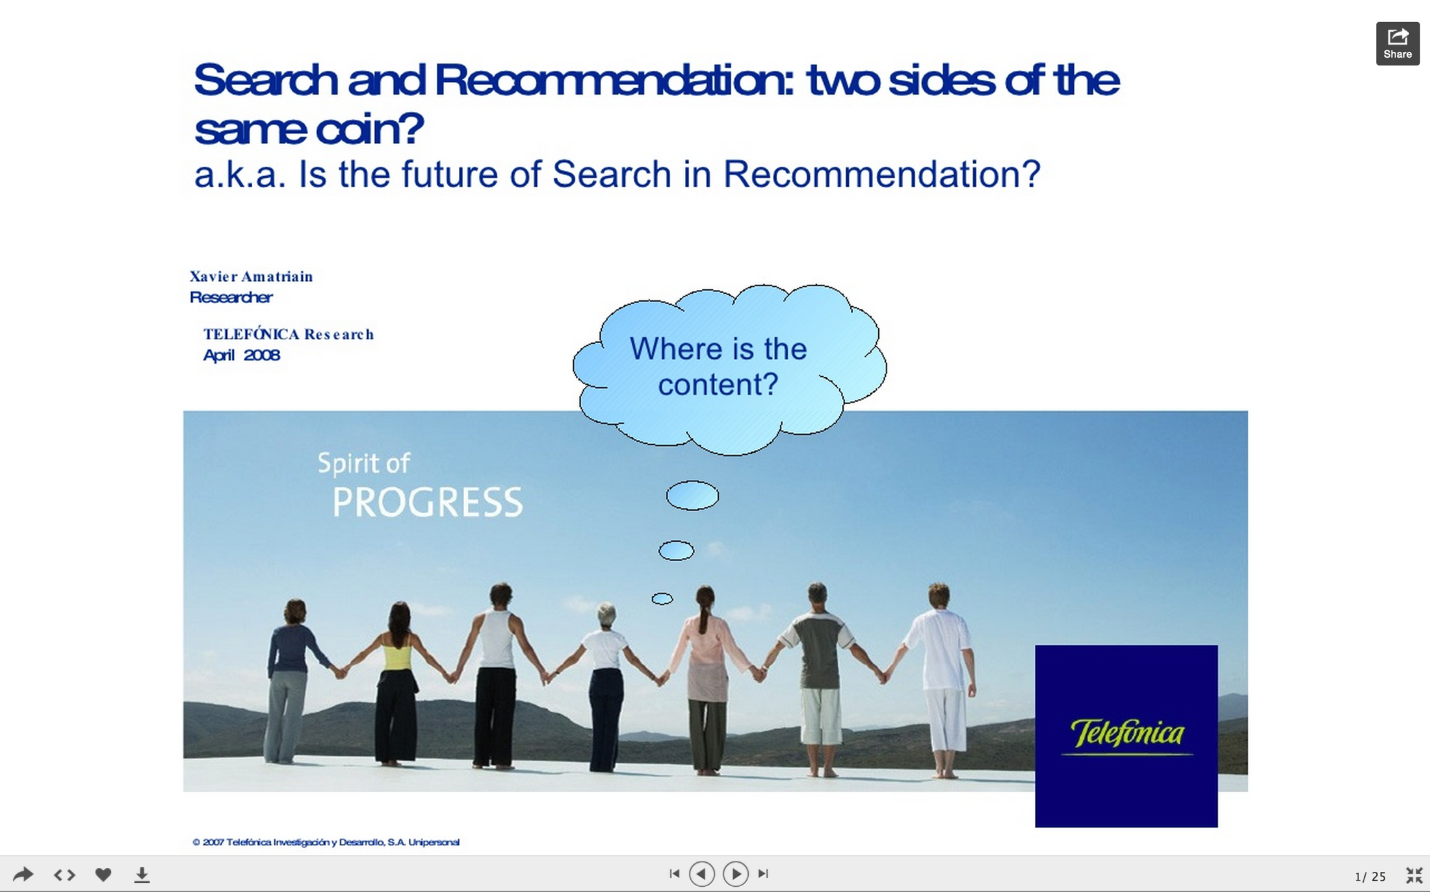
From Xavier Amatriain - Research/Engineering Director at Netflix:
http://www.slideshare.net/xamat/search-and-recommendation-2-sides-of-the-same-coin

Slide 7
Recommendations vs Search
Search – active
User has an information need
User seeks out information on the site via the search engine
Recommendations – passive
Learn from user’s behavior what they want
Push recommendations to the user – email, show in a side pane or on the homepage
Content-based recommenders are very similar to search engines

Slide 8
Effectiveness of Recommender Systems
Netflix – 2/3’s of movies \ shows are recommended
Google News – recommendations generate 38% more click-throughs
Amazon – 35% of sales are from recommendations

Slide 9
Why? From Scarcity to Abundance
Then
Before ecommerce, items sold in brick and mortar stores, shelf space was at a premium, choice limited
TV networks – limited choice of offerings
Video stores – few thousand videos / DVD’s
Music – limited to radio and personal collections
Now
Netflix – abundance of movies and shows
Spotify, Pandora, Last.fm – millions of songs to choose from
Spotify – 20M songs as of December 2012
Amazon, Ebay, etc– abundance of different buying choices for each item, from toothbrushes, to shoe horns…
Amazon – over 200M different products (http://export-x.com/2013/12/15/many-products-amazon-sell/)
Amazon – 570,000 baby products alone

Slide 10
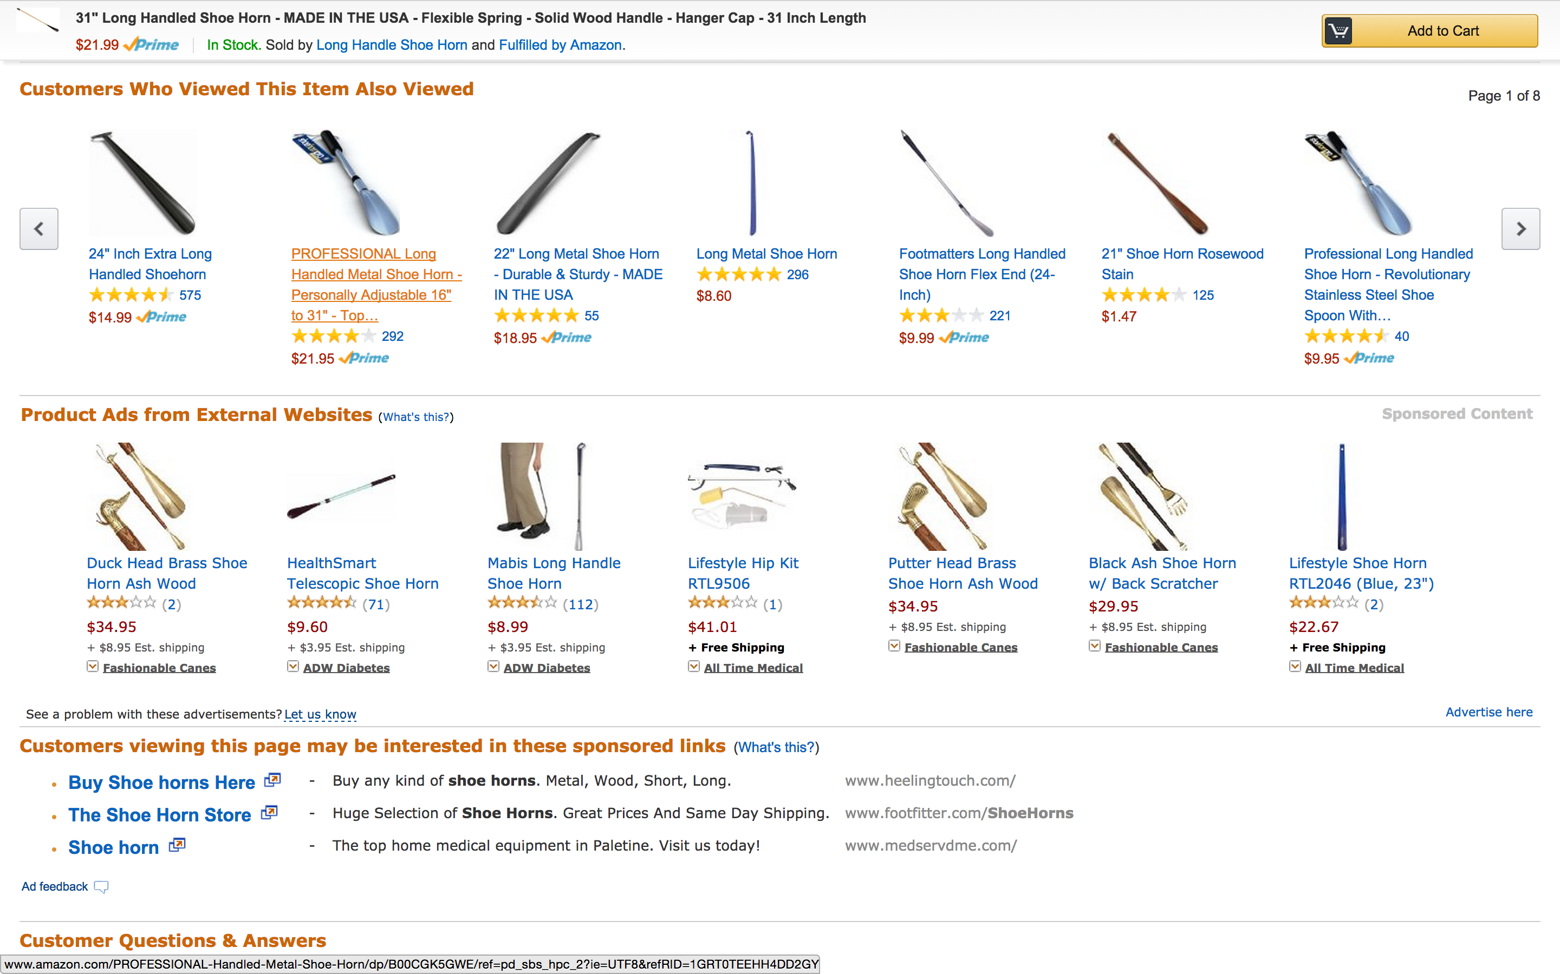
Amazon – Shoe Horns

Slide 11
Why? Information Overload
“People read about 10MB of material a day, hear 400M a day, and see one MB of information every second”
The economist, 2006
“The growth in the internet, 24-hour television and mobile phones means that we now receive five times as much information every day as we did in 1986… Every day the average person produces six newspapers worth of information compared with just two and a half pages 24 years ago – nearly a 200-fold increase.”
The (UK) Telegraph, 11/02/2011
Two key technologies for dealing with this
Search Engines (active)
Recommender Systems (passive)

Slide 12
Amazon – Data Science vs Office Politics
Some 300 years later, Greg Linden at Amazon created a prototype to show personalized recommendations based on items in the shopping cart (2).
You add an item, recommendations show up; add another item, different recommendations show up.
Linden notes that while the prototype looked promising, ―a marketing senior vice-president was dead set against it, claiming it will distract people from checking out. Greg was ―forbidden to work on this any further.
Nonetheless, Greg ran a controlled experiment, and the ―feature won by such a wide margin that not having it live was costing Amazon a noticeable chunk of change.
With new urgency, shopping cart recommendations launched. Since then, multiple sites have copied cart recommendations.
http://www.exp-platform.com/documents/guidecontrolledexperiments.pdf
Notes:
From http://www.exp-platform.com/documents/guidecontrolledexperiments.pdf last accessed 11/1/2014

Slide 13
What is a Recommender System?
Recommends items that may be of interest to you
Rather than rely on users to search for products \ content of interest, push it to them automatically
It may do this by
Recommending the most popular items from all users
Recommending the most highly rated items from all users
Find similar users based on your purchasing habits, recommend items they liked that you haven’t bought
‘User based’ recommender system
Show you items that are similar to ones you already bought
Association rule mining
‘Item based recommender system’

Slide 14
Commercial Examples
Name some popular recommender systems you’ve seen or used?

Slide 15
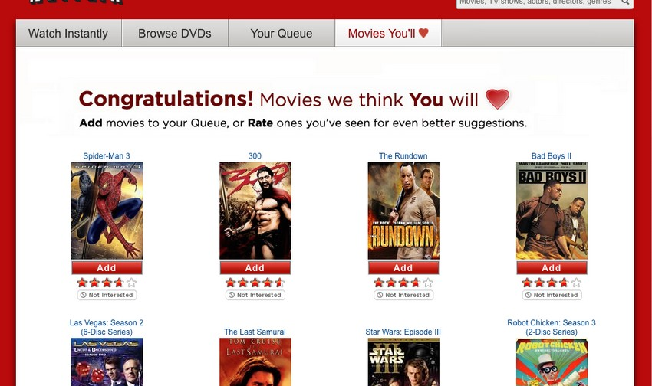
Netflix

Slide 16
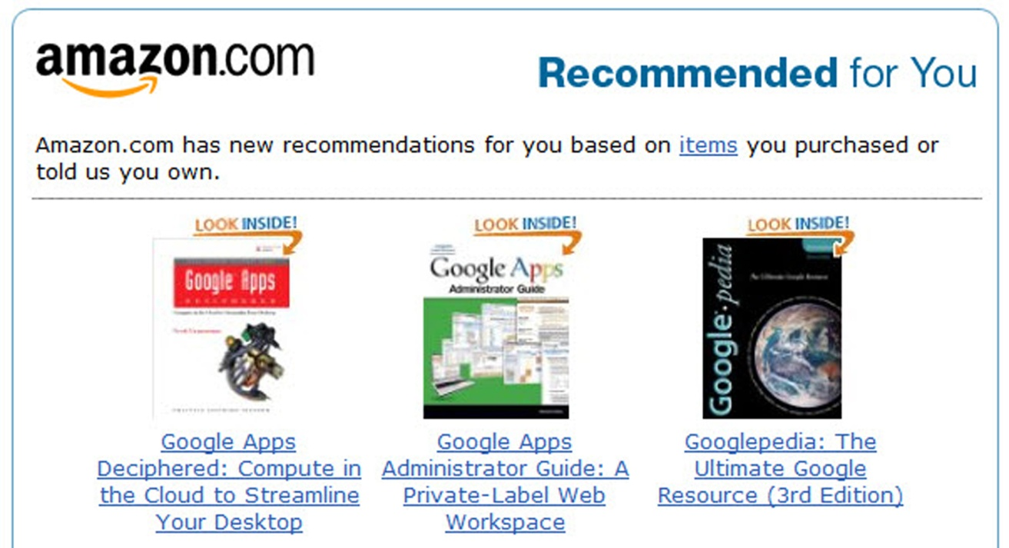
Amazon Personalized – From Purchases

Slide 17
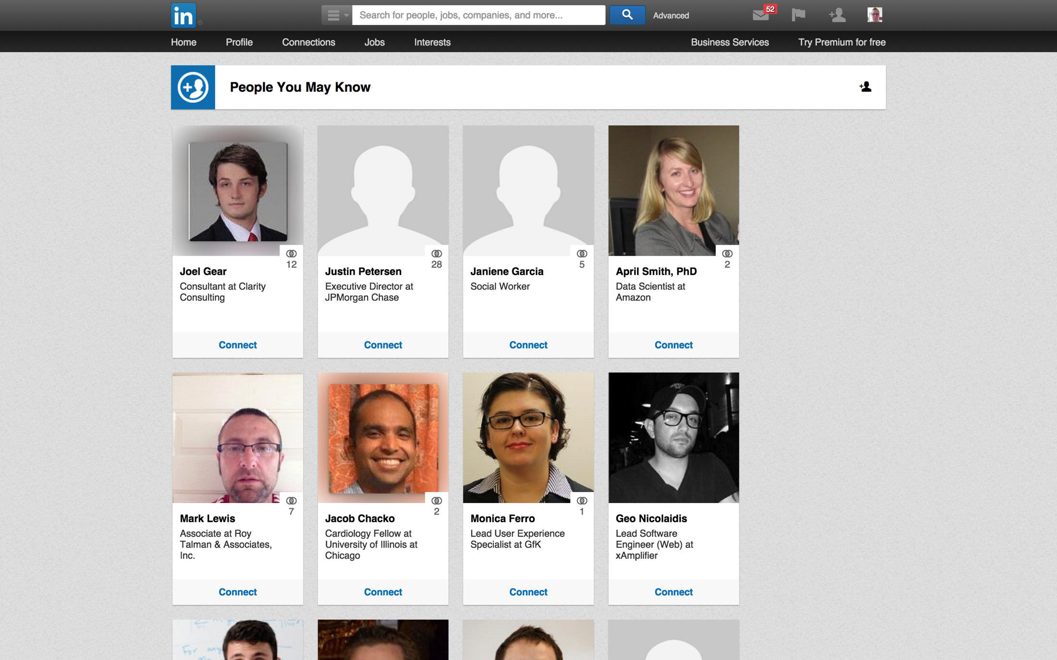
LinkedIn - People You May Know - Graph Based Recommender

Slide 18
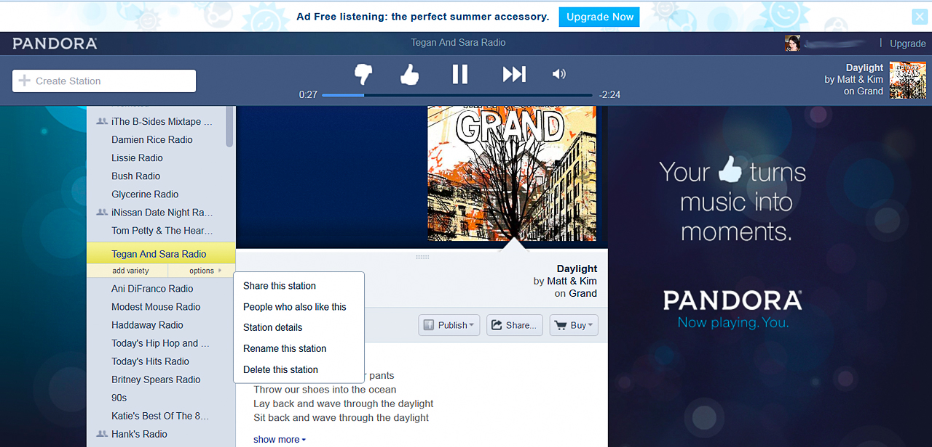
Pandora

Slide 19
Why is this Important to My Business?
One of the biggest applications of machine learning in industry
A large proportion of the employed data scientists working on recommender systems
Any company selling products or services can benefit from recommender systems
Can have a big impact on the business
75% of what people watch on Netflix comes from recommendations!
Drives customer engagement with the site
In my ~18 months at Dice.com, most of my time has been spent working on our recommender systems:
5 different recommender systems built to date for our site, 2 currently live, more to follow

Slide 20
Types of Recommender Systems
None Personalized
Usually based on ratings by all users
Personalized
Tries to learn your preferences from your behavior
2 Approaches:
Collaborative Filtering
Content Based

Slide 21
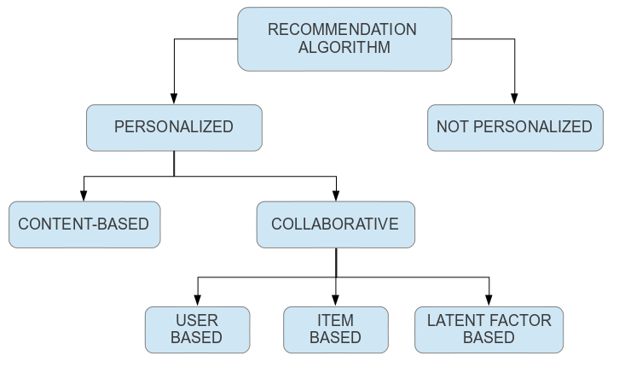
Types of Recommender System
Notes:
From http://itv.paolocremonesi.org/wiki/recommender-systems/algorithms/collaborative last accessed 10.25.2014

Slide 22
None Personalized Recommenders
Show you user’s ratings for items across all users or a panel of experts
Can just show most popular items or most highly rated
More sophisticated approaches exist using reinforcement learning (lecture one)
E.g. Yahoo news
Some examples:

Slide 23
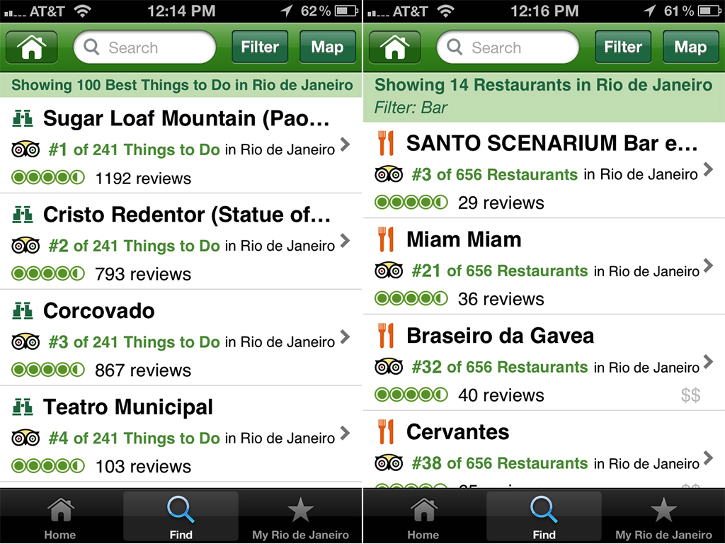
Travel Recommendations -Trip Advisor

Slide 24
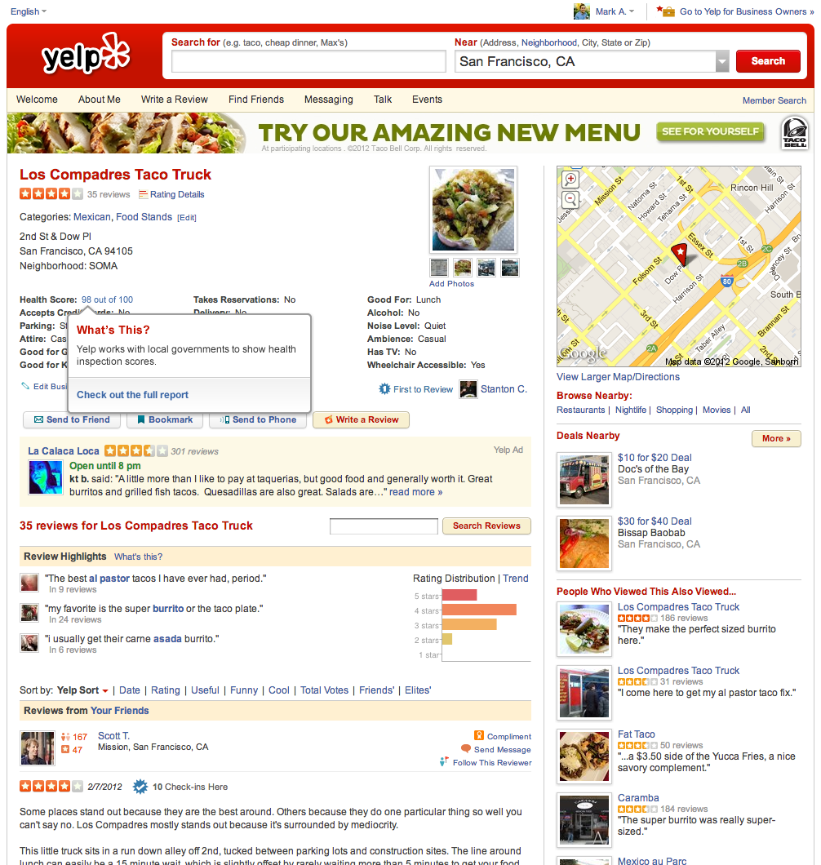
Yelp Reviews

Slide 25
None Personalized Recommender - Challenges
Rating Skew
Are most reviews 4-5 stars?
Some users mean ratings differ a lot from others
Solution: Normalize ratings so that all lie on the same scale
Exploration \ Exploitation
If you want to show the most popular, how do you handle new items?
Often more recent items are more important, e.g. when recommending news articles
Solution: Reinforcement learning – determines optimal balance between exploration \ exploitation

Slide 26
None Personalized Recommender - Challenges
Majority Opinion Only
The majority opinion may not match that of individual users, who have their own tastes and biases
Solution: Personalized recommendations
Review Quality \ Bias
What differentiates a good reviewer from a bad reviewer?
Are your users biased?
Are some reviewers bots or paid?
Solution: Use expert reviewers only.
Learn which users are trustworthy (e.g. wikipedia, stack overflow)
Use recognized domain experts (e.g. movie review sites)

Slide 27
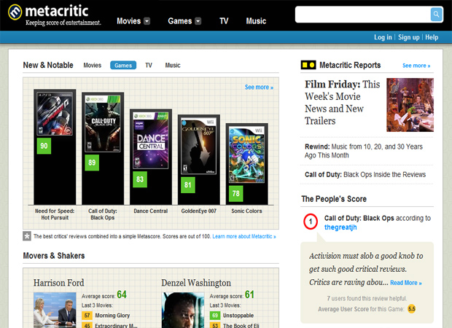
Expert Reviews – Meta Score

Slide 28
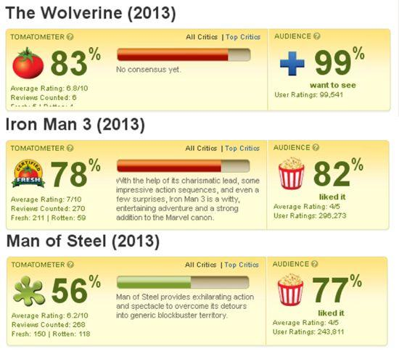
Expert Reviews – Rotten Tomatoes

Slide 29
Personalized Recommender Systems
Provide recommendations personalized to the user, as opposed to using a community’s views as a whole
User receives targeted recommendations relevant to them based on their profile and \ or past behavior on the site
2 Approaches:
Collaborative Filtering
Content based

Slide 30
Collaborative Filtering
Use user behavior only to drive recommendations
Behavior – past purchases, website browsing history, Netflix queue, Amazon wish list, job applications, etc.
3 approaches:
User Based
Find similar users based on past known behavior
Recommend items they’ve liked, watched, bought or listened to that you haven’t yet
Item Based
Look at which items are often bought together or by the same users
Suggest new items similar to those you’ve bought or watched before
User-Item
Latent factor models.
Learns new features from user-item matrices that represent taste preferences

Slide 31
Some of the Algorithms
User based
K-nearest neighbor
Item based
Association Rule Mining
K-nn on the item-item matrix
Linear regression per item
Slope one (linear regression ignoring gradient, using intercept term only)
User-Item
Latent factor models.
Factorize the user-item matrix.
Multi-label, multi-class classification \ regression problem
SVD (dimensionality reduction) – compress matrix, and then decompress – fills in missing ratings
Factorization Machines
Deep neural networks

Slide 32
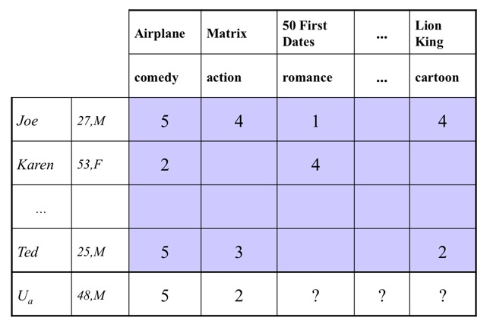
User Item Matrix

Slide 33
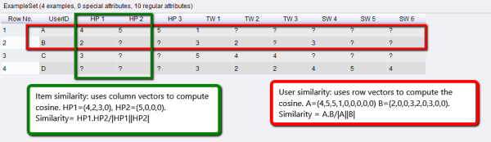
Knn: User Similarity \ Item Similarity
Similarity Measures Used:
Cosine similarity
Euclidean Distance
Pearson’s correlation
Jaccard (intersection / union)
Notes:
From http://www.simafore.com/blog/bid/207476/The-intuition-behind-recommender-systems-collaborative-filtering, last accessed 11/1/2014

Slide 34
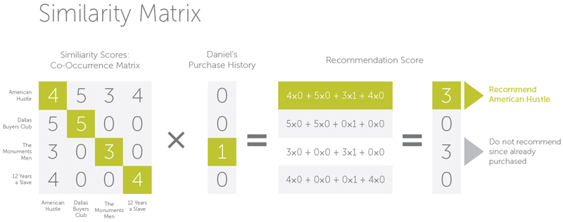
Item-based Collaborative Filtering
Notes:
From http://blog.operasolutions.com/bid/387700/Data-Science-Recommender-Engines-with-Collaborative-Filtering, last accessed 11/1/2014

Slide 35
Advantages \ Disadvantages of Different CF Approaches
Accuracy?
Novelty?
Complexity?
User-based
Item-based
User-Item
Discuss…

Slide 36
Advantages \ Disadvantages of Different Collaborative Filtering Approaches
User-based
Advantage: Novelty – discovers items totally unlike those you’ve purchased before (new movie genres to you, new artists, etc)
Disadvantage: Assumes tastes are the same in all areas. Two people may both love action movies, but not share tastes in romantic comedies. Typically less accurate than Item-Item
Item-based
Advantage: Very accurate – picks items very similar to those you’ve bought previously. High likelihood you’ll like more of the same
Disadvantage: Won’t recommend items that aren’t similar to your past purchases. Won’t suggest new genres you may like or already like but haven’t watched on the site yet.
User-Item:
Advantages: Potentially combines the best of both worlds
Disadvantages: Matching different items – more complex algorithms required.

Slide 37
What kind of data about users can we use to build a recommender system?
Discuss

Slide 38
What kind of data about users can we use to build a recommender system?
2 main types of feedback:
Explicit
Ratings (e.g. Netflix 5 star)
Like\Dislike (e.g. Pandora’s thumbs up \ down)
Intended Purchases \ Movie Rentals:
Movies in your queue
Items in your amazon wish list
Implicit
User browsing habits
On site click trail
Movies you’ve viewed
Items you purchased

Slide 39
Challenges with Collaborative Filtering
What are some of the problems you may encounter when building a collaborative filtering algorithm from these data points?
Discuss

Slide 40
Challenges with Collaborative Filtering
What are some of the problems you may encounter when building a collaborative filtering algorithm from these data points?
New Users?
New Items?
Large numbers of users and items – need to compute user-item matrix

Slide 41
Challenges with Collaborative Filtering
Scalability
User-item matrices can be massive if you have millions of users or items
Algorithms used in recommenders – matrix factorization, knn, don’t scale well
Can take advantage of data sparsity, but computing challenges still substantial
Solutions: Depends on the algorithm. Parallel computing. Matrix factorization to compress the data to reduce computation time. Use clustering to speed up knn – less accurate but faster
Grey Sheep
Users whose preferences don’t consistently agree or disagree with other users prove challenging for user-based CF
Will get poor recommendations
Can negatively impact recommendations for the rest of the user base
Solutions: Item based approach. Use clustering to remove grey sheep as outliers.

Slide 42
Challenges with Collaborative Filtering
Black Sheep
Users that have very idiosyncratic tastes
Solutions: Item based CF. Clustering \ anomaly detection to remove black sheep
Shilling Attacks
Manipulation of the system by malicious parties, with vested interests in promoting some items over others
Solution: Adversarial machine learning – emerging field of study. Identify such users using machine learning techniques
Rating Skew
Some users tend to rate most items positively. Others the opposite.
Solution: Normalize ratings per user (e.g. standard normalization)

Slide 43
Challenges with Collaborative Filtering
Cold Start
How to handle new users?
How to handle new items?
Solution: Content based recommenders or hybrid system. Recommend most popular items (beware positive feedback)
Sparsity (Related)
Movie rating system – millions of users, thousands to millions of movies. Each user viewed up to a few hundred items – maybe 1% of the data is populated, if that
Each row and column filled mostly with 0’s or nulls
Solutions: Matrix factorization to compress the data. Content-based recommenders

Slide 44
Content Based Recommender Systems
Recommend content based on common features extracted from users and items
For each item, create an item profile
Extract a set of features common to all items
E.g. Movies – actors, directors, genre, content rating, year of release, etc
E.g. Book – author, genre, length, year of publication, language, etc
E.g. social network – set of friends
E.g. images \ videos – meta data, tags
For each user, learn what types of items they like, and use that to generate recommendations
E.g. Movies – action movies, starring Arnold Schwarzenegger, released in the 1980’s
Builds a taste profile for each user

Slide 45
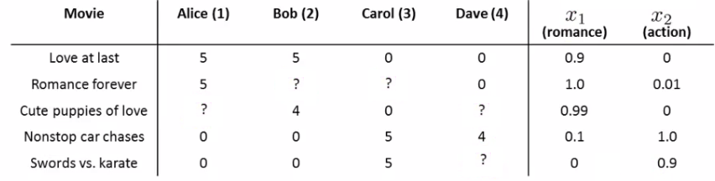
User-Item Matrix
Note the content features on the right for each item
Notes:
From http://www.holehouse.org/mlclass/16_Recommender_Systems.html, last accessed 11/2/2014

Slide 46
Content Based Recommender Systems – Text Documents
Item profile: set of “important words” that best describe the document
A common heuristic from NLP- extract the top n terms by their Tf.Idf score (Term Frequency * Inverse Document Frequency) for the document

Slide 47
Content Based Recommender Algorithms
Use techniques from information retrieval (i.e. search engine technologies) which essentially do k-nearest neighbor matching, at scale
Create a separate linear regression model per user, that takes in a feature vector per item and predicts a rating
Matrix factorization, such as latent factor models

Slide 48
Which of these Problems Does Content-Based Recommendation Solve?
Cold start?
Data sparsity?
Scalability?
Shilling attacks?
Black-grey sheep?
Diversity?
Will it recommend novel items dissimilar from those purchased \ rated?
Discuss

Slide 49
Advantages of Content-Based Recommender Systems
Solves the cold start problem for new items
Don’t need other users to recommend items
Can recommend new or unpopular items (have item profiles)
Solves the black and gray sheep problems
Can recommend to users with unique tastes
Can address the sparsity problem (every item has a set of features)
Harder to game the system (shilling attacks)
Recommendations are based on features not specific items or users
Can provide justification for recommendations

Slide 50
Disadvantages of Content Based Recommender Systems
Finding useful features may be hard
E.g. images, movies and music (hard to box movies or songs into specific genres)
Lack of Diversity
It won’t recommend items outside of user’s taste profile
Will only recommend movies in genres rated by the user
User-based collaborative filtering is very good at this
Cold start for new users
How do you recommend items for new users without a taste profile?
Solutions:
Recommend most popular (however - can cause undesirable positive feedback)
Recommend from the average taste profile until user has rated some items

Slide 51
Case Studies - Amazon
A wide variety of different recommender products
A pioneer in this field

Slide 52
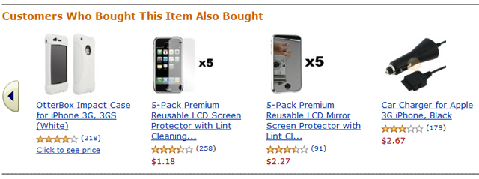
Amazon – Customers Also Bought…

Slide 53
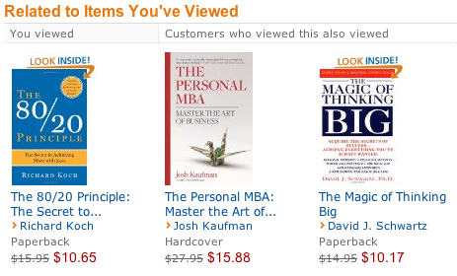
Amazon – Personalized from Browsing History

Slide 54
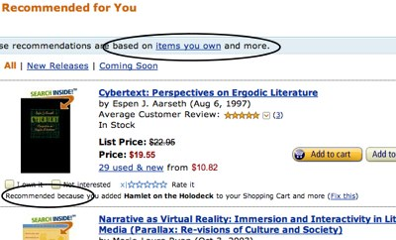
Amazon – Personalized with Justification

Slide 55
Pandora – The Music Genome
A taxonomy of music attributes and tastes used to drive their recommender engine
Pandora employs 50 musicians trained listen to songs and describe each song using over 450 characteristics.
Each musician has a 4-year music degree, and undergone intensive training in their rigorous and precise methodology
These characteristics capture not only the musical identity of the songs, but many qualities relevant to understanding their users’ music preferences
The database currently has over 600k songs
Over half are independent, unsigned bands.
Any band can submit their music.
More: http://www.pandora.com/about/mgp

Slide 56
Pandora – What Type of Recommender System?

Slide 57
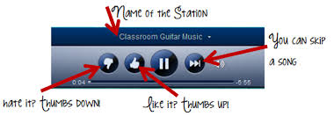
Pandora – What Type of Recommender System?
Content-based. But wait…

Slide 58
Pandora – What Type of Recommender was System?
Content-based. But wait…
Hybrid Recommender System:
Content-based – Music Genome - large database of songs, described using a series of features
Collaborative Filtering – gather user feedback on listening preferences as they listen
Thumbs up
Thumbs down
Skip

Slide 59
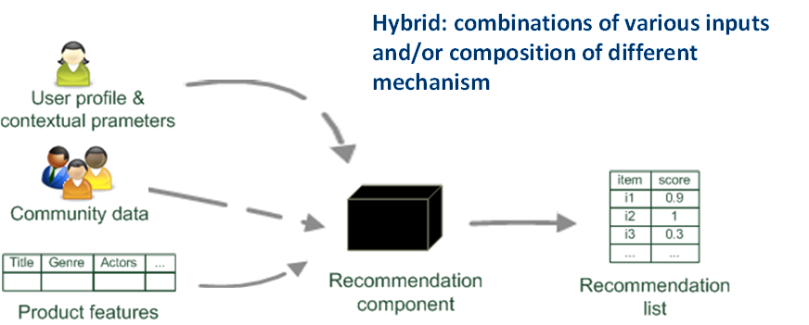
Hybrid Recommender System
Notes:
From http://blog.soton.ac.uk/comp6051-bazinga/2013/04/22/analysis-of-recommender-systems/ last accessed 11/1/2014

Slide 60
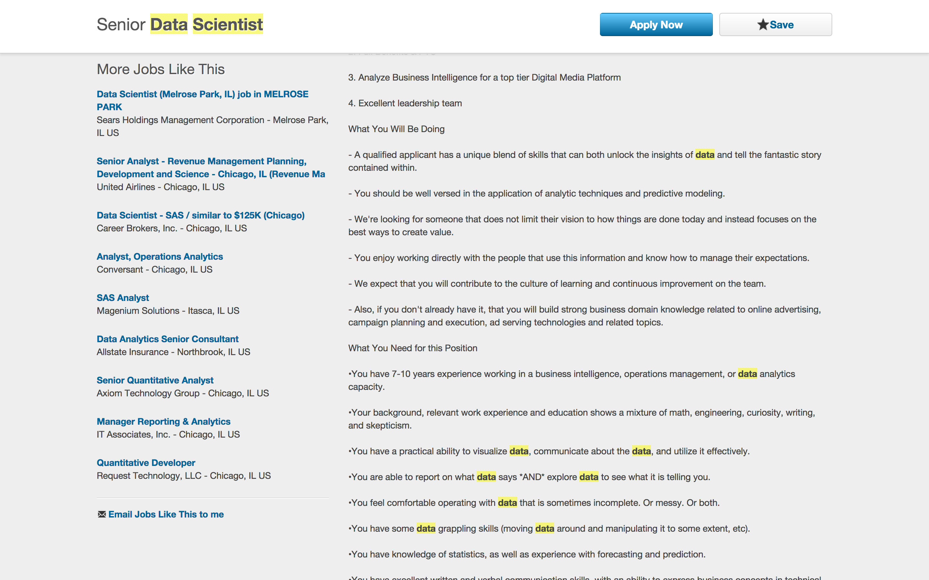
Case Study – Dice.com “More Jobs Like This”

Slide 61
Dice.com Recommenders - Challenges
Cold start
Sparsity
Scalability (More Candidates Like This)
Bots – large numbers of applies
Hybrid Recommender – Content-Based with Collaborative Filtering component
3X increase in clicks compared to previous system (off-the-shelf product)

Slide 62
Useful Links
Netflix recommendations
http://techblog.netflix.com/2012/04/netflix-recommendations-beyond-5-stars.html
Amazon recommendations
http://www.aboutdm.com/2013/01/product-recommendation-by-amazon.html

